Slide 1
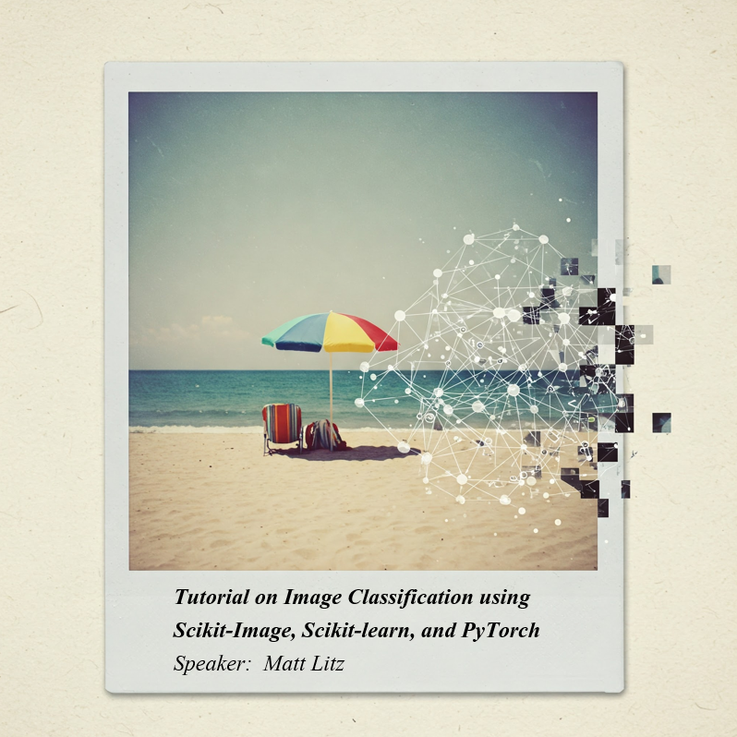
Tutorial on Image Classification using Scikit-Image, Scikit-learn, and PyTorch
Matt Litz
Data Science Engineer
Github repo

Slide 2
Agenda
Computer Vision
Image Segmentation
Feature Extraction
Model Development - scikit-learn
* scikit-learn
* PyTorch
5. Model Performance
* Tensorboard
* Saliency map

Slide 3
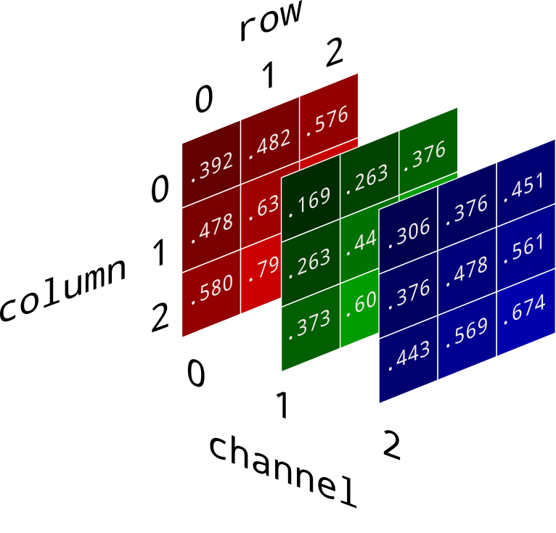
How is an image represented in a computer?
Images are represented digitally in a computer as a grid of pixels, where each pixel is assigned a specific color or intensity value, typically encoded in binary form using a certain number of bits.
Skimage reads image files (.jpg, .tif) into python as numpy arrays
Bit depth is important for machine learning because it determines the range of color or intensity values that can be represented
Higher bit count providing more detailed information and potentially improving model performance by capturing subtle variations in the data
8 bit
12 bit
16 bit
uint8

Slide 4
Image Processing Tools
Scikit-image
Skimage is part of the NUMFOCUS suite of software packages
Collection of algorithms for image processing
Maintained by an active community of volunteers
Figi (ImageJ)
Fiji is an image processing package—a “batteries-included” distribution of ImageJ2, bundling a lot of plugins which facilitate scientific image analysis

Slide 5
Image Classification Pipeline
Segmentation
Feature Extraction
Classification

Slide 6
Image Segmentation

Slide 7
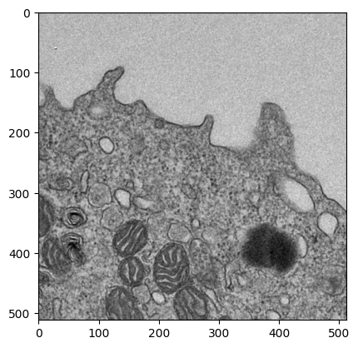
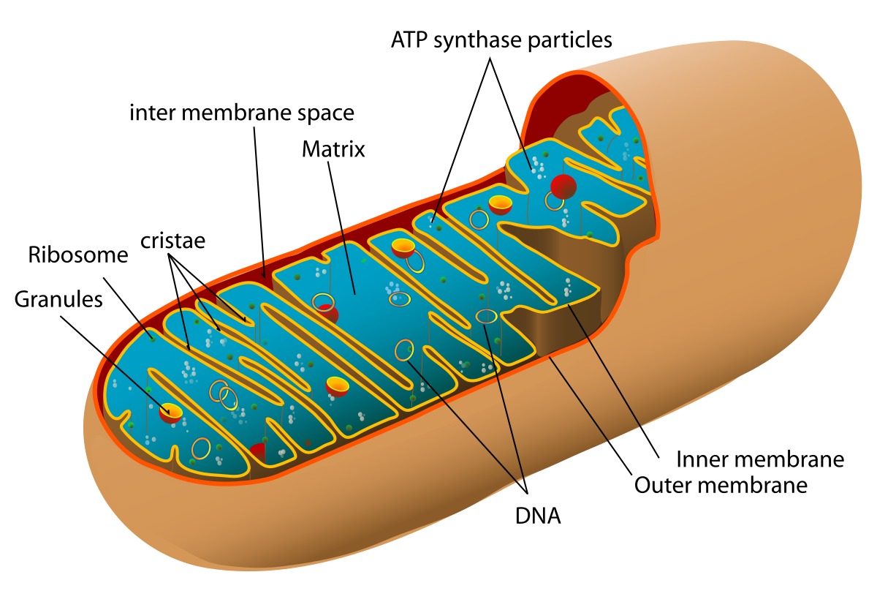
Segmentation Problem Statement
Let’s utilize the image processing tools available in scikit-image to segment out mitochondria
Strategy:
Remove the mitochondria from the image for classification
Mitochondria are organelles with a membrane found in the cells of most eukaryotic organisms, and can be thought of the “power plant of the organism through its production of ATP

Slide 8
Image Segmentation – Typical Order of Operations
Preprocessing
Noise reduction, normalization, and contrast enhancement
Thresholding
to separate foreground from background
Morphological Operations
(erosion, dilation, etc.) to refine boundaries

Slide 9
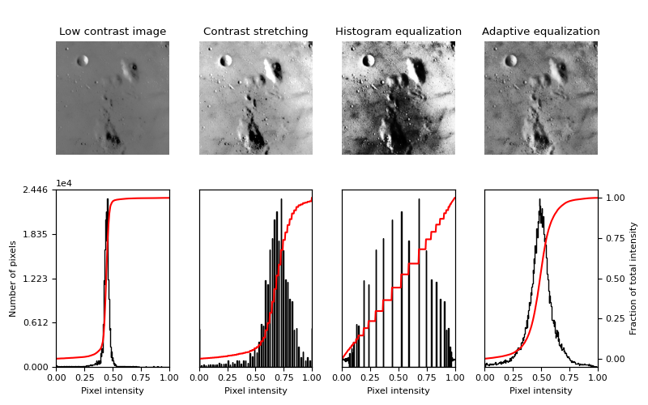
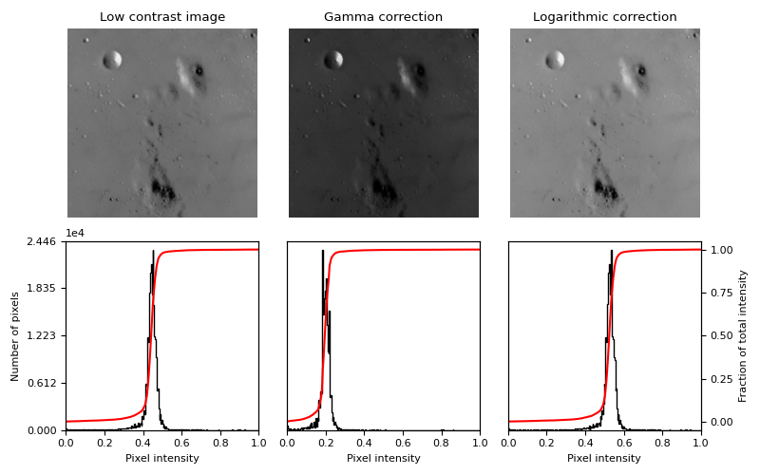
Preprocessing - Histogram equalization and Gamma Adjustment
Definition of equalization
Our goal is to increase contrast between pixels
Histogram equalization is a contrast enhancement technique that redistributes the intensity values of an image to achieve a uniform histogram, thereby improving the overall contrast.
Adaptive equalization
Contrast Limited Adaptive Histogram Equalization (CLAHE).
An algorithm for local contrast enhancement, that uses histograms computed over different tile regions of the image. Local details can therefore be enhanced even in regions that are darker or lighter than most of the image.
Gamma Correction
Gamma correction is a nonlinear operation used to encode and decode luminance or tristimulus values in images, adjusting the brightness to match the nonlinear response of display devices and human vision.

Slide 10
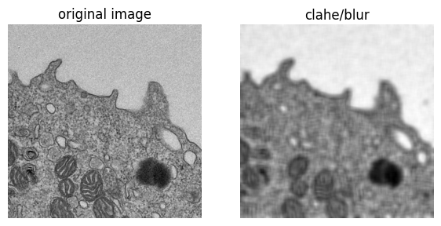
Preprocessing - Filtering Operations
We utilize image filtering to reduce artifacts and produce more uniform regions in the image
Gaussian Blurring
Gaussian blurring is an image filter that smooths an image using convolution operations with a Gaussian kernel,thus reducing noise and detail.
Bilateral Blurring
Bilateral blurring is an image filter that smooths an image while preserving edges by averaging pixel values

Slide 11
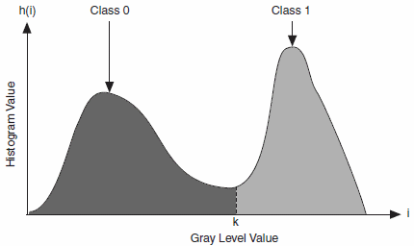
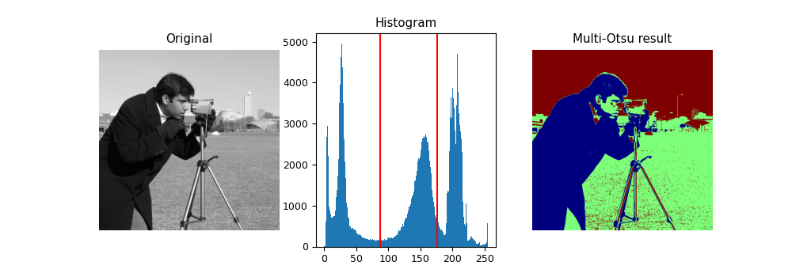
Thresholding
Thresholding is used to create a binary image from a grayscale image
Otsu’s Method
Seeks to find optimal thresholding by maximizing between-class variance
Similar to KL-divergence
Multi-Otsu Method
thresholding algorithm that is used to separate the pixels of an input image into several different classes, each one obtained according to the intensity of the gray levels within the image

Slide 12
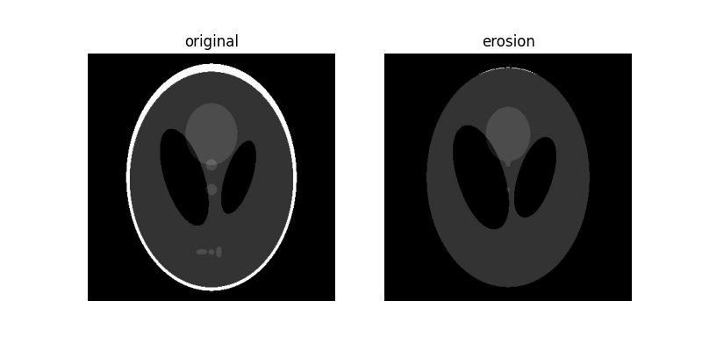
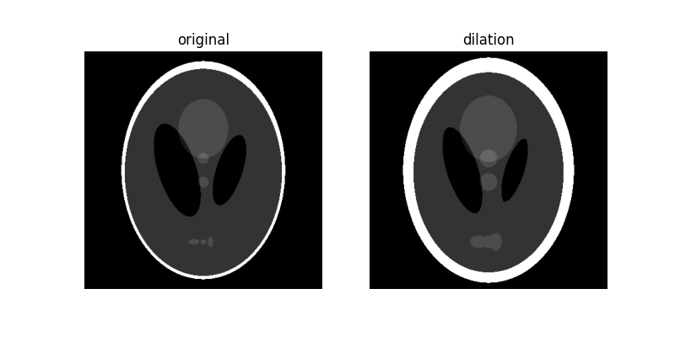
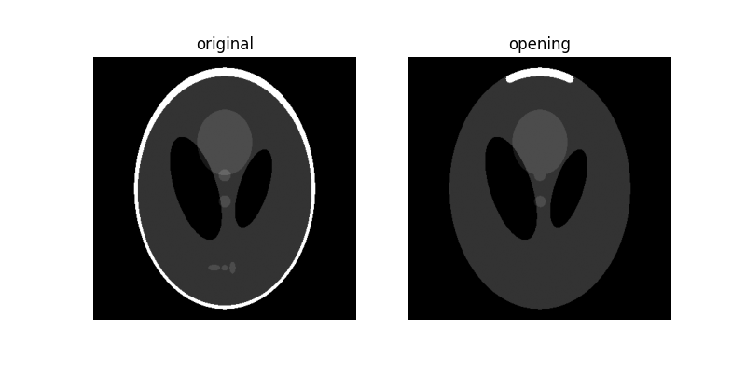
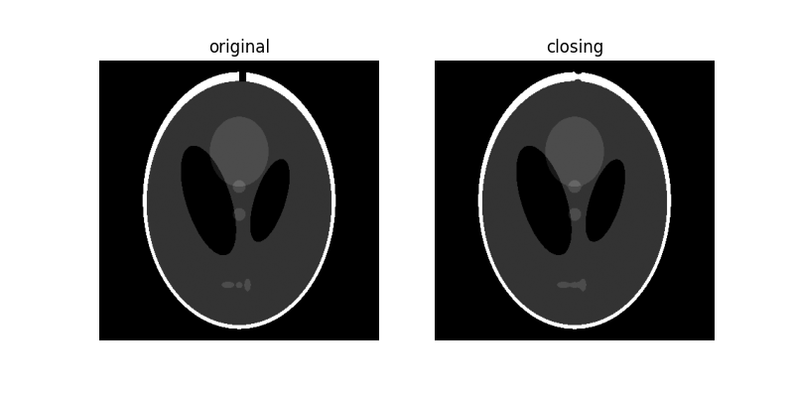
Morphological Operations
Binary image morphology:
dilation
erosion
opening
closing
A structuring element, footprint, is often used to describe the neighborhood of pixels
Covered in scikit-image’s morphology class
Erosion - shrinks bright regions
Dilation - enlarges bright regions and shrinks dark regions
Closing - dilation followed by an erosion
Opening - erosion followed by a dilation

Slide 13
Feature Selection

Slide 14
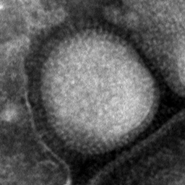
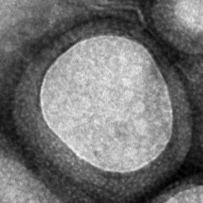
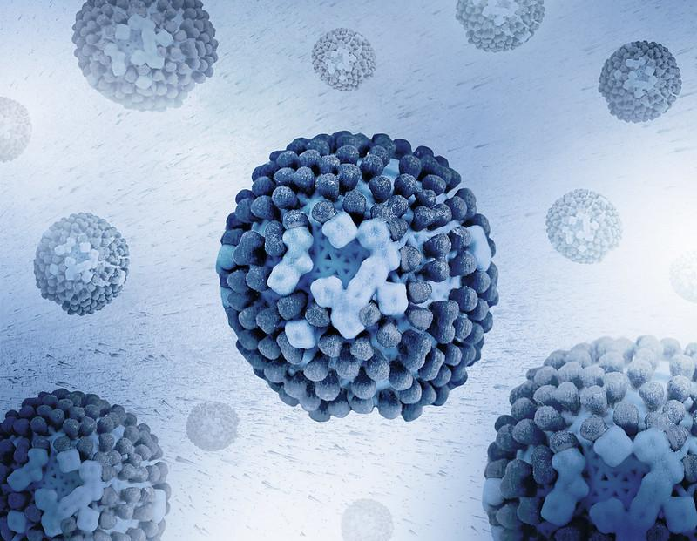
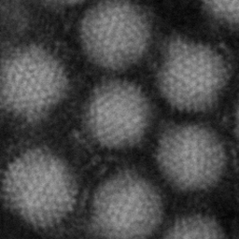
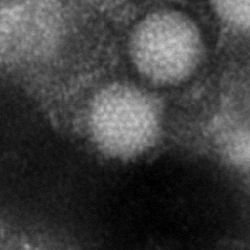
Problem Statement
Adenoviruses and Influenza have similar symptoms but often different levels of severity.
Using transmission electron microscopy (TEM) images, we can classify the viruses
Influenza model
Sources:
[1] https://www.nbcnews.com/health/health-news/virus-looks-flu-acts-flu-it-s-not-influenza-n840651
[2] https://user.it.uu.se/~gusky180/virustexture/
Adenovirus model

Slide 15
Common Features
Common features derived from images
mean
variance
We can also extract textures
Textures in images quantify:
Grey Level differences (contrast)
Defined size of area where change occurs (neighborhood, defined by a window size)
Directionality, or lack of it (omnidirectional)
Quantifying the texture of an image provides additional features from which we can train on

Slide 16
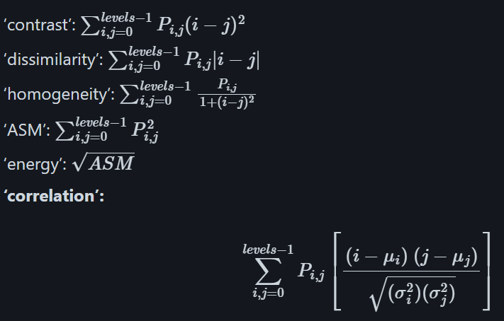
Quantifying Texture: GLCM and LBP
GLCM
The gray-level co-occurrence matrix (GLCM) is a statistical method of examining texture that considers the spatial relationship of pixels
Texture measures derived from the GLCM are
Contrast
Dissimilarity
Homogeneity
ASM
Energy
Correlation
Local binary patterns (LBP) I
Another method for finding local texture measure
Local Binary Pattern (LBP) in scikit-image is a texture descriptor that:
Works by comparing each pixel with its neighbors
Creates a binary code for each pixel based on these comparisons
Converts these codes to decimal numbers
Builds a histogram of these values as the feature vector

Slide 17
Model Building

Slide 18
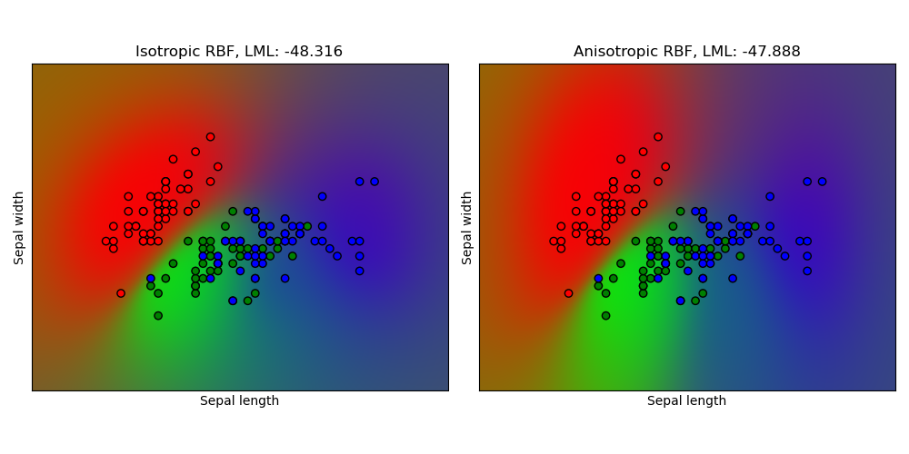
Gaussian Process Classification
A Gaussian Process is a probabilistic model used in machine learning to define a distribution over functions, providing predictions with associated uncertainties by modeling data with a multivariate Gaussian distribution.
Kernel Function:
Utilizes a kernel as a covariance function
The ARD kernel used in this example is a type of covariance function that includes separate length-scale parameters for each input dimension, allowing the model to automatically determine the relevance of each feature.
Model Training:
During training, the GP learns the hyperparameters of the ARD kernel, including the length-scales, by maximizing the marginal likelihood, which helps in identifying which input dimensions are more important.
Prediction:
For a new input, the GP uses the learned kernel to compute the mean and variance of the predicted output, providing both a prediction and a measure of uncertainty.
GP Lecture
https://www.youtube.com/watch?v=R-NUdqxKjos

Slide 19
Gaussian Process Classification Data Pipeline
Training Images
Dataframe of features
GP
Prediction
Test Images

Slide 20
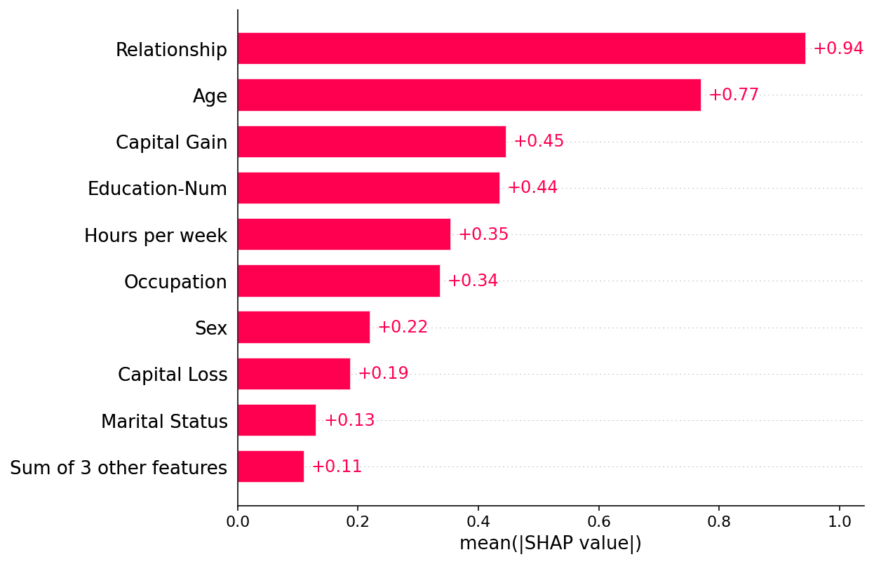
Feature Importance
SHAP (SHapley Additive exPlanations) is a game theoretic approach to explain the output of any machine learning model.
The core idea behind Shapley value based explanations of machine learning models is to use fair allocation results from cooperative game theory to allocate credit for a model’s output f(x) among its input features.
In this example we will determine feature importance by using the SHAP bar plot to get the mean absolute value of each feature over all the instances (rows) of the dataset

Slide 21
Key Model Performance Evaluation Metrics
Accuracy: Accuracy is the ratio of correctly predicted instances to the total instances, providing a straightforward measure of a model's performance, but can be misleading in image classification with imbalanced datasets.
F1 Score: The F1 score is the harmonic mean of precision and recall, providing a balanced measure of a model's accuracy, especially important in image classification when dealing with imbalanced classes.
Precision: Precision is the ratio of true positive predictions to the total predicted positives, indicating the accuracy of positive predictions, crucial in image classification to minimize false positives.
Recall: Recall, or sensitivity, is the ratio of true positive predictions to the actual positives, reflecting the model's ability to identify all relevant instances, important in image classification to ensure all target objects are detected.

Slide 22
PyTorch – CNN
PyTorch has a reputation for being difficult!
Provides great understanding of how neural networks work
Widely used by researchers across computer vision and natural language processing
PyTorch Lightning is also a good package for production deployment and under-the-hood calculations of performance metrics

Slide 23
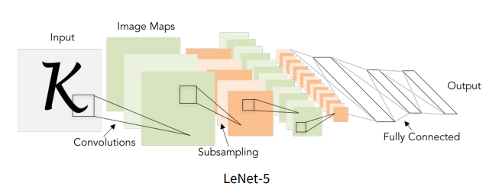
PyTorch – CNN
Load Images
Set up Dataset class
Dataloader
Define CNN Architecture
Augmentation
Train loop
Validation loop
Evaluate on Random Images
Monitor training with Tensorboard

Slide 24
PyTorch – CNN Architecture
class CNNModel(nn.Module):
def __init__(self):
super(CNNModel, self).__init__()
self.features = nn.Sequential(
nn.Conv2d(1, 32, kernel_size=3, padding=1),
nn.BatchNorm2d(32),
nn.ReLU(),
nn.MaxPool2d(2, 2),
nn.Conv2d(32, 64, kernel_size=3, padding=1),
nn.BatchNorm2d(64),
nn.ReLU(),
nn.MaxPool2d(2, 2),
nn.Conv2d(64, 128, kernel_size=3, padding=1),
nn.BatchNorm2d(128),
nn.ReLU(),
nn.MaxPool2d(2, 2),
# Adaptive pooling layer
nn.AdaptiveAvgPool2d((6, 6))
)
self.fc_block = nn.Sequential(
nn.Linear(128 * 6 * 6, 256),
nn.ReLU(),
nn.Dropout(0.25),
nn.Linear(256, 1)
)
BatchNorm2d: BatchNorm2d normalizes the inputs of each mini-batch for 2D convolutional layers, stabilizing learning by reducing internal covariate shift and accelerating convergence.
MaxPool2d: MaxPool2d performs down-sampling by dividing the input into rectangular pooling regions and outputting the maximum value from each region, reducing spatial dimensions and computational load.
AdaptiveAvgPool2d: AdaptiveAvgPool2d outputs a fixed-size feature map by adjusting the pooling regions dynamically, ensuring the output dimensions are consistent regardless of input size.
Dropout: Dropout randomly sets a fraction of input units to zero during training, preventing overfitting by encouraging the model to learn more robust features.

Slide 25
CNN - Data Augmentation
RandomCrop
Data augmentation in PyTorch involves applying random transformations to training data, such as rotations, flips, and color adjustments, to artificially expand the dataset and improve model generalization.
v2.compose
Apply to training set
Applies a sequence of transformations to EVERY image in the batch
RandomRotation
RandomResizeCrop

Slide 26
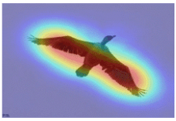
Model Performance: Saliency Maps
In PyTorch, model interpretability can be enhanced by generating saliency maps
These maps visualize model gradients by highlighting the regions of an input image that most influence the model's prediction
These maps are typically represented as grayscale images, with brighter areas indicating higher importance.
Helpful for
Understanding Model Decisions
Model Debugging

Slide 27
PyTorch – Transfer Learning - Fine-tuning ResNet50
The intuition behind transfer learning for image classification is that if a model is trained on a large and general enough dataset, this model will effectively serve as a generic model of the visual world.
Feature Extraction: Use the representations learned by a previous network to extract meaningful features from new samples. You simply add a new classifier, which will be trained from scratch, on top of the pretrained model so that you can repurpose the feature maps learned previously for the dataset.
Fine-Tuning: Unfreeze a few of the top layers of a frozen model base and jointly train both the newly-added classifier layers and the last layers of the base model. This allows us to "fine-tune" the higher-order feature representations in the base model in order to make them more relevant for the specific task.

